Slide 1
Error in python
Why/ when do they occur
How to handle them
Try except clause
Generators

Slide 2
Python Errors
IndexError
ModuleNotFoundError
KeyError
ImportError
TypeError
ZeroDivisionError
Etc;

Slide 3
Error Categories
Syntax Error
Logic Error
Runtime Error

Slide 4
Generators
Use of Python Generators
There are several reasons that make generators a powerful implementation.
1. Easy to Implement
Generators can be implemented in a clear and concise way as compared to their iterator class counterpart. Following is an example to implement a sequence of power of 2 using an iterator class.
2. Memory Efficient
A normal function to return a sequence will create the entire sequence in memory before returning the result. This is an overkill, if the number of items in the sequence is very large.
Generator implementation of such sequences is memory friendly and is preferred since it only produces one item at a time.

Slide 5
Generators
3. Represent Infinite Stream
Generators are excellent mediums to represent an infinite stream of data. Infinite streams cannot be stored in memory, and since generators produce only one item at a time, they can represent an infinite stream of data.
The following generator function can generate all the even numbers (at least in theory).
4. Pipelining Generators
Multiple generators can be used to pipeline a series of operations. This is best illustrated using an example.
Suppose we have a generator that produces the numbers in the Fibonacci series. And we have another generator for squaring numbers.
If we want to find out the sum of squares of numbers in the Fibonacci series, we can do it in the following way by pipelining the output of generator functions together.

Slide 6
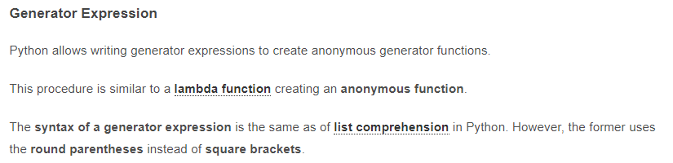

Slide 7
1. When will the else part of try-except-else be executed? a) always b) when an exception occurs c) when no exception occurs d) when an exception occurs in to except block
2. When is the finally block executed? a) when there is no exception b) when there is an exception c) only if some condition that has been specified is satisfied d) always

Slide 8
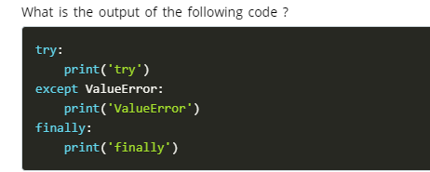

Slide 9
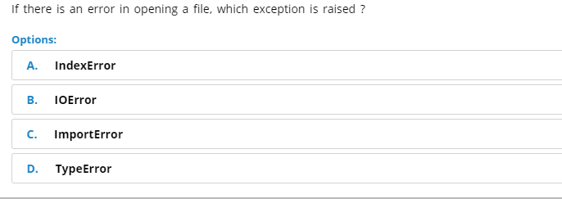
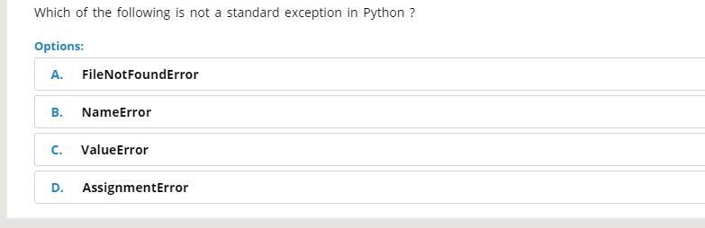

Slide 10
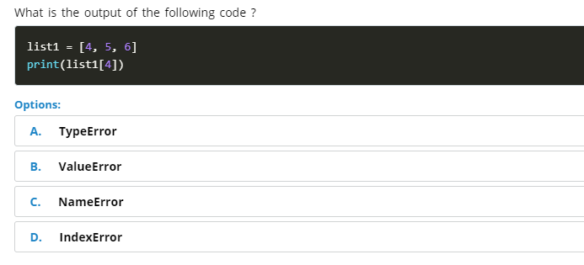
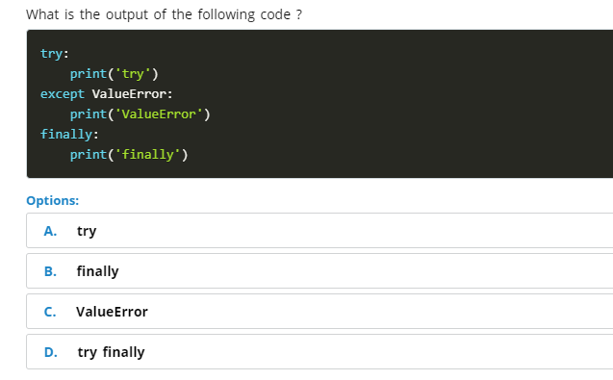

Slide 11
JSON, CSV, XML
JSON: JSON refers to JavaScript Object Notation. It is a language-independent, human-readable language used for its simplicity and is most commonly used in web-based applications. The JSON extensions end with a .json. JSON is a user-friendly substitute for XML as it is lightweight and easy to read. It supports data structures like array and objects and the JSON documents that are rapidly executed on the server.
CSV: CSV refers to Comma-Separated Values. It holds plain text as a series of values (cells) separated by commas (, ) in a series of lines (rows). CSV file can actually open in a text editor and read it. There are lots of applications for reading CSV files, and many languages provide built-in functions that simplify reading/writing CSV format. These files are majority used by professionals in data analysis or visualizations.

Slide 12
XML (Extensible markup language) was designed to carry data, not to display data. It is a W3C recommendation. Extensible Markup Language (XML) is a markup language that defines a set of rules for encoding documents in a format that is both human-readable and machine-readable. The design goals of XML focus on simplicity, generality, and usability across the Internet. It is a textual data format with strong support via Unicode for different human languages. Although the design of XML focuses on documents, the language is widely used for the representation of arbitrary data structures such as those used in web services.
<Geeks>
<Geek>
<firstName>Vivek</firstName>
<lastName>Kothari</lastName>
</Geek>
<Geek>
</Geek><firstName>Peter</firstName>
<lastName>Gregory</lastName>
</Geeks>

Slide 13
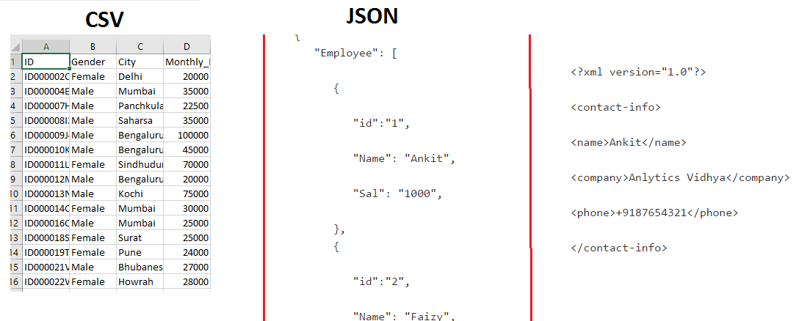

Slide 14
Why should a data scientist understand different file formats?
Usually, the files you will come across will depend on the application you are building. For example, in an image processing system, you need image files as input and output. So you will mostly see files in jpeg, gif or png format.
As a data scientist, you need to understand the underlying structure of various file formats, their advantages and dis-advantages. Unless you understand the underlying structure of the data, you will not be able to explore it. Also, at times you need to make decisions about how to store data.
Choosing the optimal file format for storing data can improve the performance of your models in data processing.

Slide 15
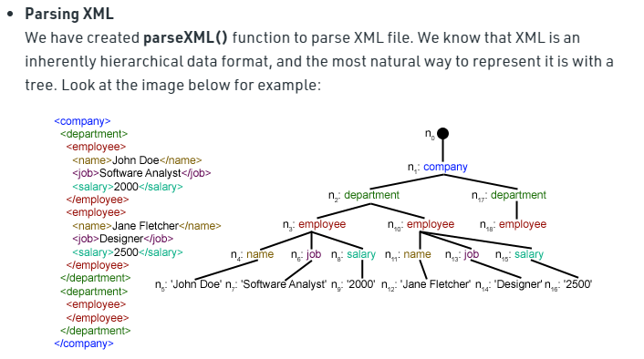

Slide 16
Following are the various File Modes in Python:
Mode | Description
'r' | This is the default mode. It Opens file for reading.
'w' | This Mode Opens file for writing. If file does not exist, it creates a new file. If file exists it truncates the file.
'x' | Creates a new file. If file already exists, the operation fails.
'a' | Open file in append mode. If file does not exist, it creates a new file.

Slide 17
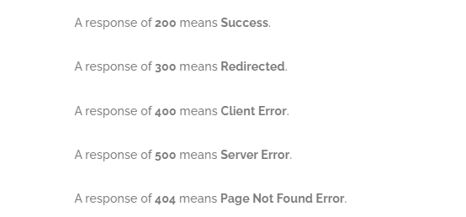

Slide 18
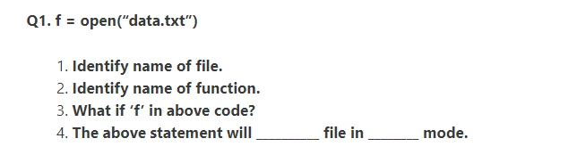


Slide 19
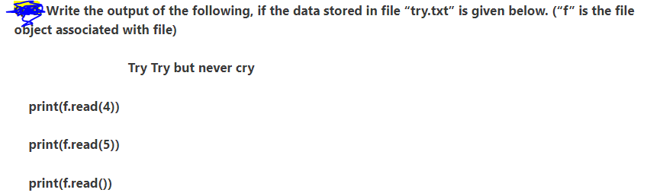

Slide 20
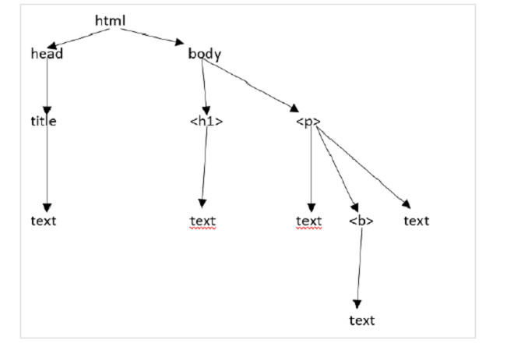

Slide 21
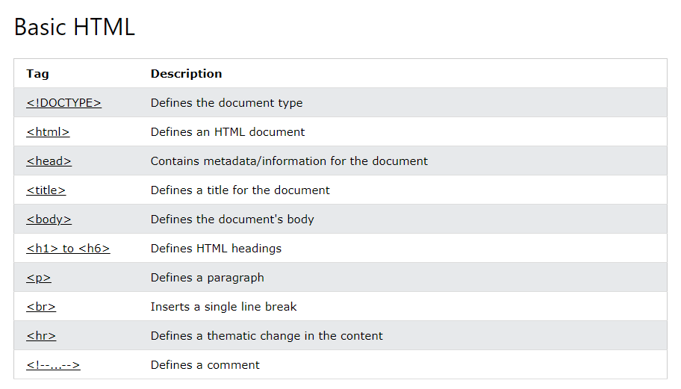

Slide 22
POST requests are never cached
POST requests do not remain in the browser history
POST requests cannot be bookmarked
POST requests have no restrictions on data length

Slide 23
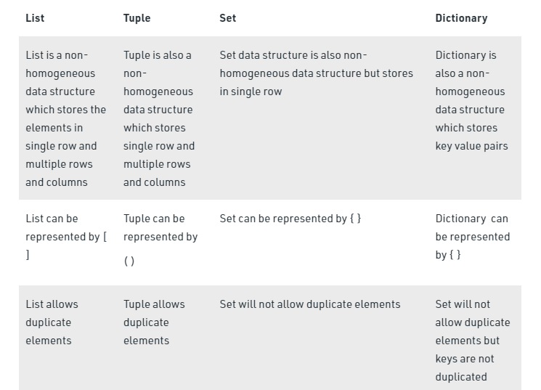

Slide 24
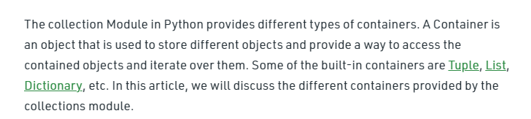

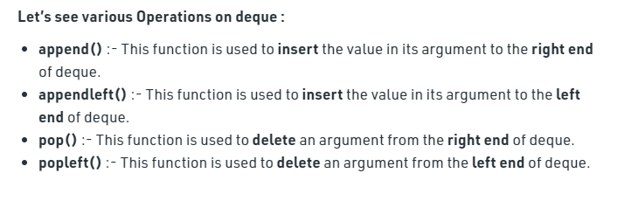

Slide 25

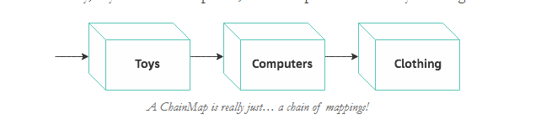

Slide 26
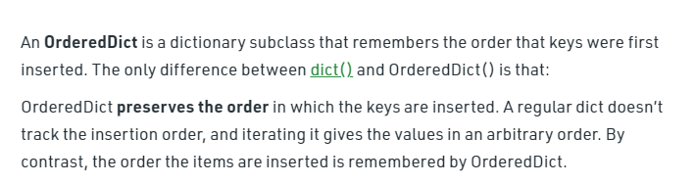
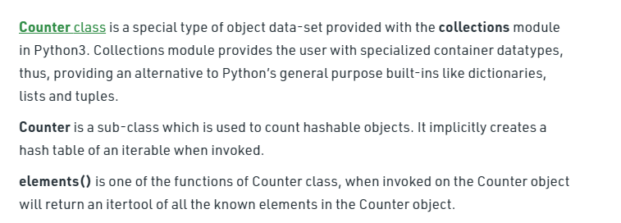

Slide 27
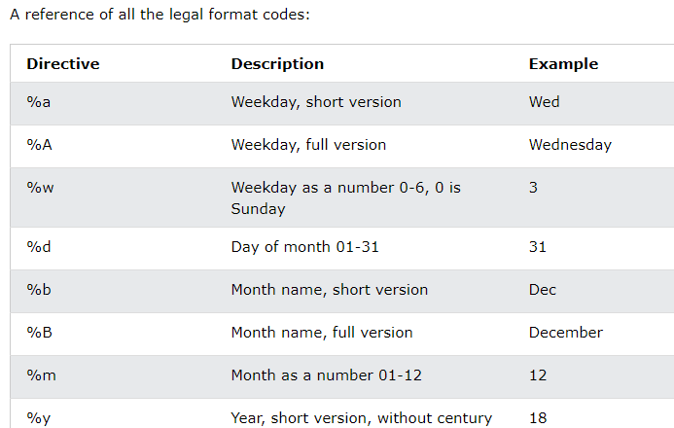
DateTime strftime()

Slide 28
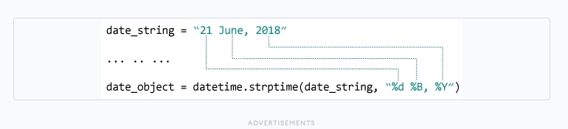

Slide 29
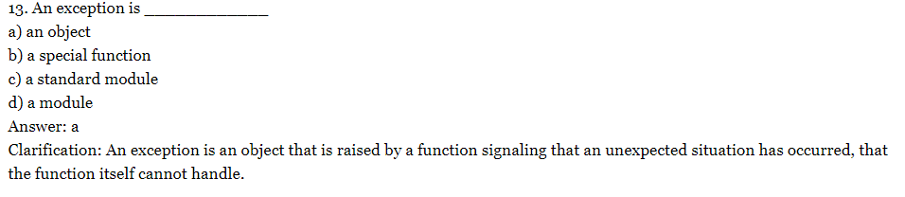
Q1
Create try expect code lines raising multiple exceptions.
try:
x = float(input("Your number: "))
inverse = 1.0 / x
except ValueError:
print("You should have given either an int or a float")
except ZeroDivisionError:
print("Infinity")
finally:
print("There may or may not have been an exception.")
Q2

Slide 30
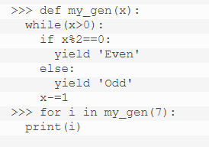
Q3
Create an anonymous/expressions generator function.
Q4
Create combination of a for loop and generator to derive the below output.

Slide 31
Q5
Read the csv file at url : ('http://winterolympicsmedals.com/medals.csv') with both the methods.
/
Q6
Read an xml file using find and findall command
Check the request status once you send the request to this url.
https://www.aljazeera.com/news/2020/06/03/coronavirus-travel-restrictions-border-shutdowns-by-country/
Q7

Slide 32
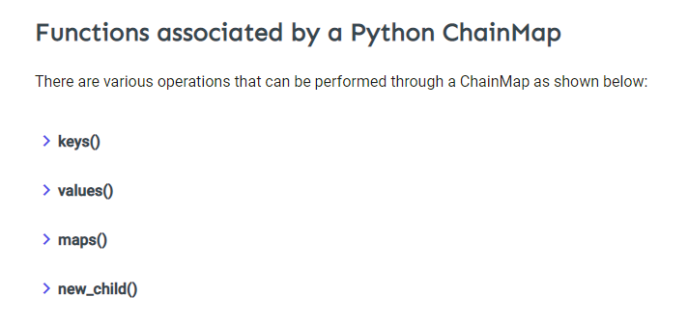

Slide 33
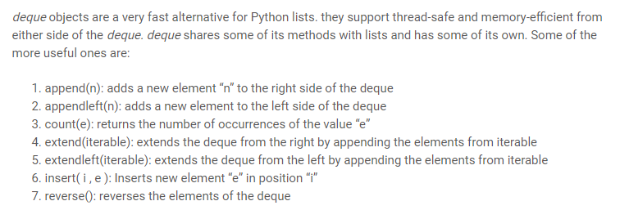
Deque or Double Ended Queue is a generalized version of Queue data structure that allows insert and delete at both ends.

Slide 34
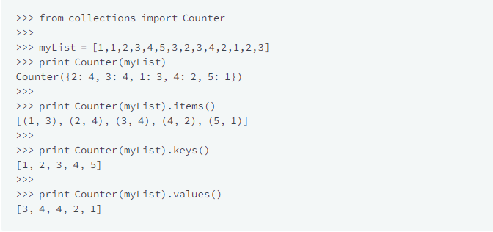
A counter is a container that stores elements as dictionary keys, and their counts are stored as dictionary values.

Slide 35
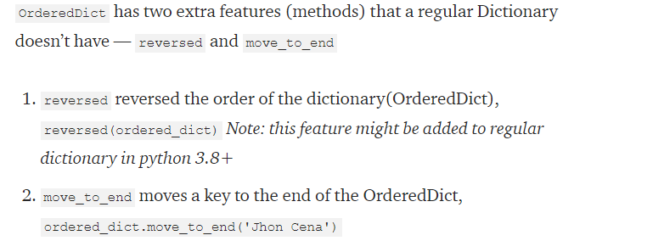
OrderedDict preserves the order in which the keys are inserted.

Slide 36

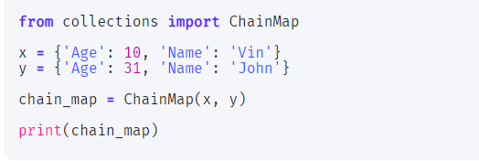

Slide 37
Write a Python script to display the various Date Time formats.
a) Current date and time b) Current year c) Month of year d) Week number of the year e) Weekday of the week f) Day of year g) Day of the month h) Day of week
Write a Python program to convert a string to date time?
Sample String : Jan 1 2014 2:43PM Expected Output : 2014-07-01 14:43:00

